Slide 1
Final Project Presentation
CSE8803HNC Fall 2016
Contact: Professor Fang (Cherry) Liu
fang.liu@oit.gatech.edu

Slide 2
PETSc Implementation of a Computational Model of the Guinea Pig Ear
Thomas Bowling
CSE 8803 Final Project
November 30, 2016

Slide 3
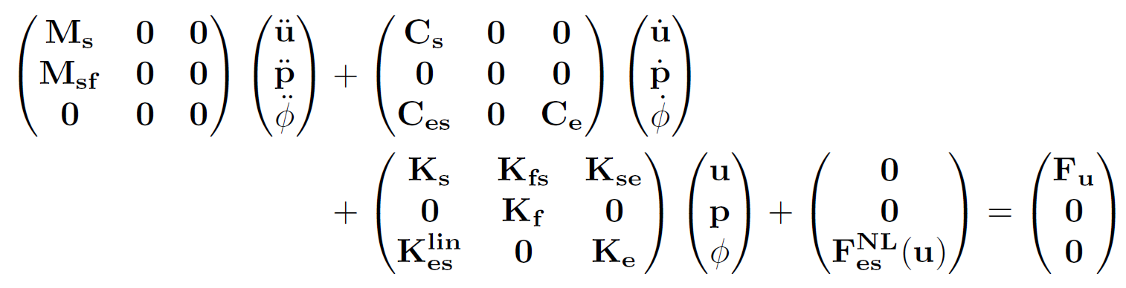
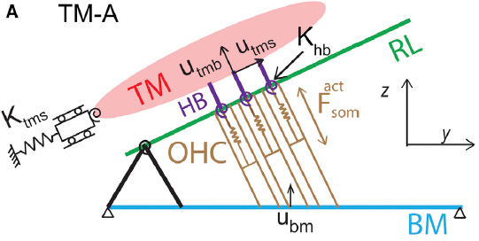

Model Formulation
Model FEM Equations
mechanical
pressure
electrical
Assume harmonic response
Meaud and Grosh, Biophysical J., 2014
This system of equations, Av=F, can be solved with direct or KSP methods
The matrix A is non-symmetric, so use CGS, Bi-CGSTAB, or GMRES to solve

Slide 4
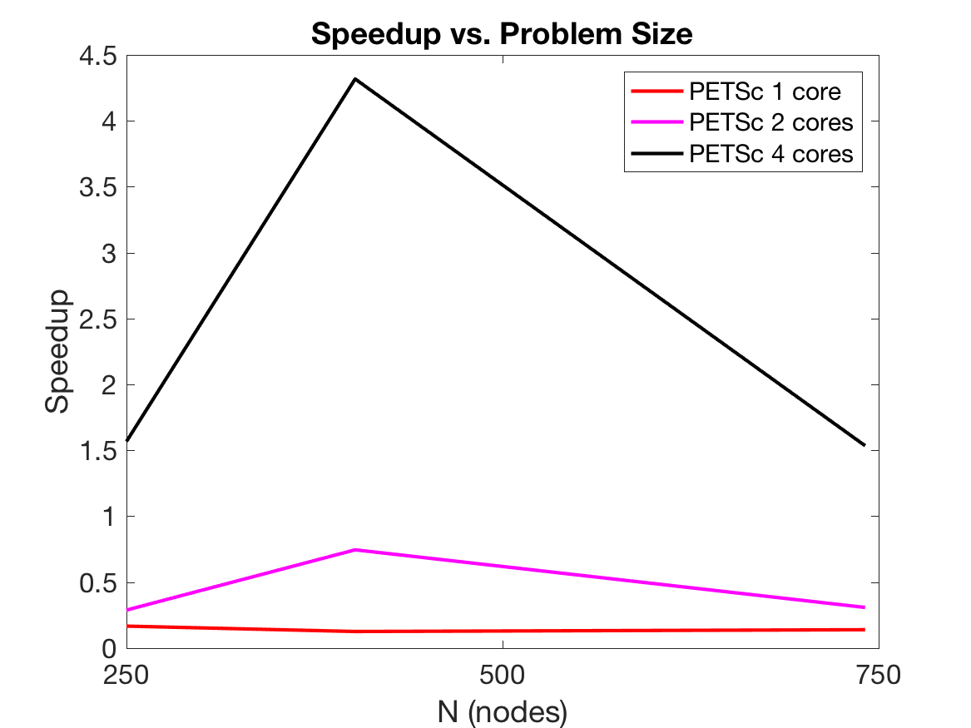
PETSc Implementation
Code broken into several steps
  Assembly FEM matrices
  Combine FEM matrices to give M, C, K matrices
  Solve system using Bi-CGSTAB with Jacobi preconditioning
Using only 1 or 2 cores with PETSc is actually slower than MATLAB, but PETSc with 4 cores is faster
Fine-tuning is needed to improve performance

Slide 5
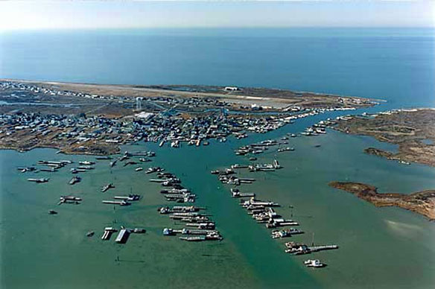
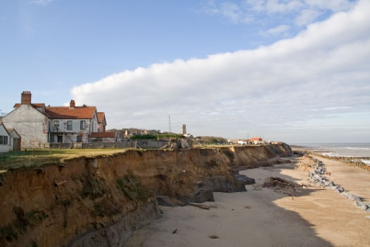
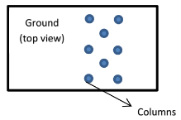
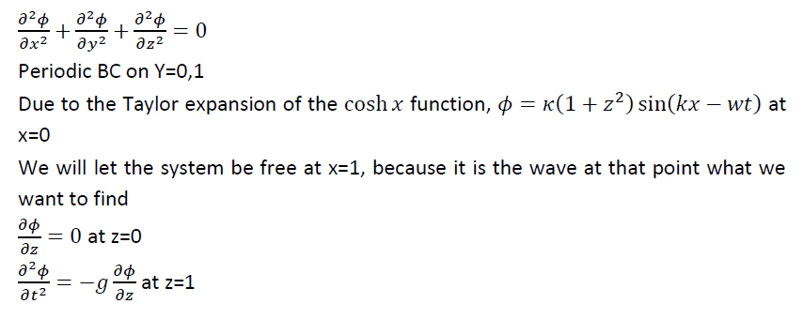
Ocean wave protective system
Jonas Cuadrado
Ocean waves are eroding the coast! Protection is needed
Simple model that gcribe waves
Notes:
Images: Happisburg, Norwich; and Tangier Island, VA

Slide 6
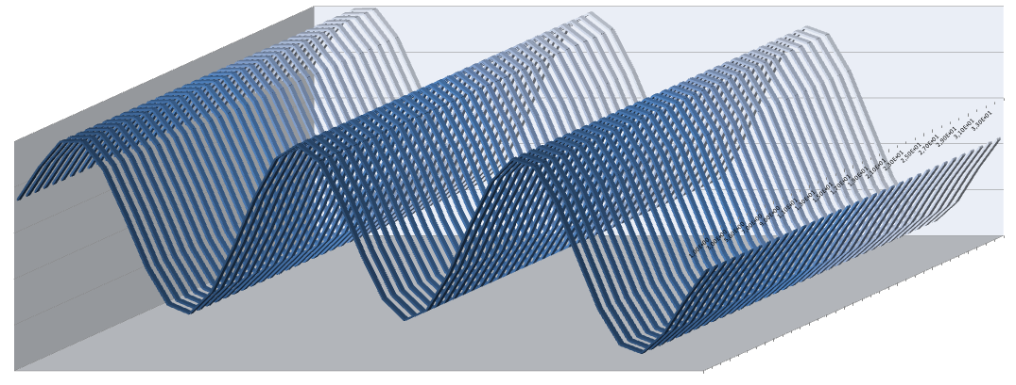
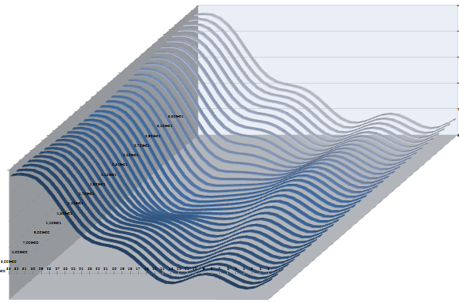
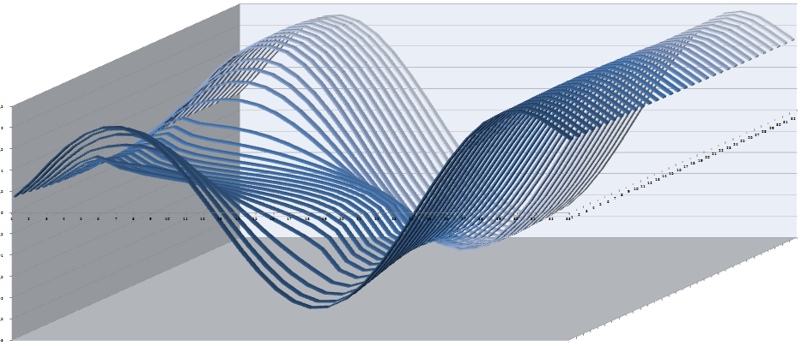
Code validation
Observed correct description of the waves
Obstacles perturb the wave for noticeable distances

Slide 7
Parallel performance
Cannot assure the convergence of the Laplacian always
Default CG converges more often than CG-MG, but when MG does, is way better
Time dependence convergence is quadratic
Iteration | Change in norm infinity of solution
0 | -
1 | 1,04E-04
2 | 1,46E-04
3 | 1,71E-05
4 | 8,98E-05
5 | 2,96E-05
6 | 1,78E-05
7 | 9,64E-06
8 | 5,01E-06
9 | 2,46E-06

Slide 8
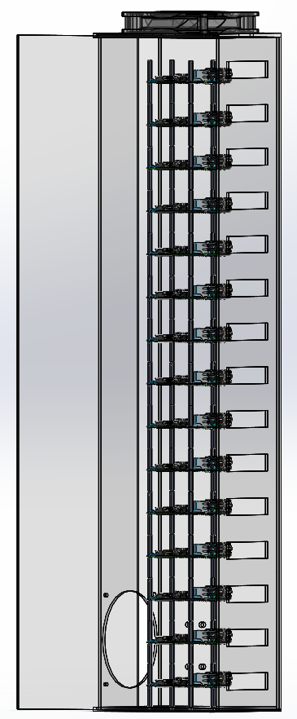
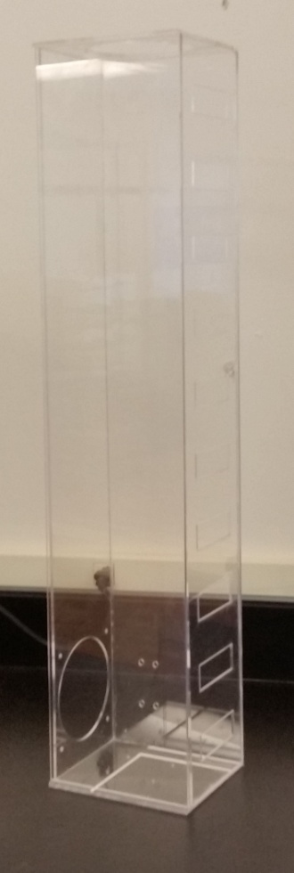
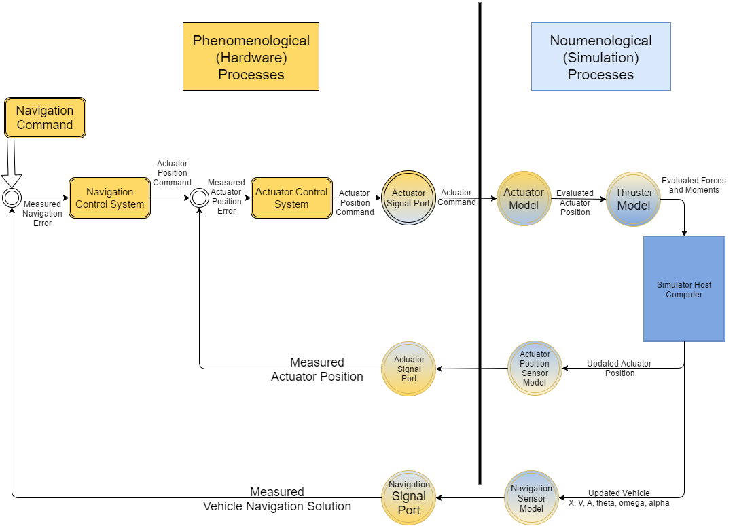
Development of a Scalable Algorithm for Determining Line-of-Sight Connectivity in Satellite Constellations
Chris DeGraw, CSE8803-HNC
November 30, 2016

Slide 9
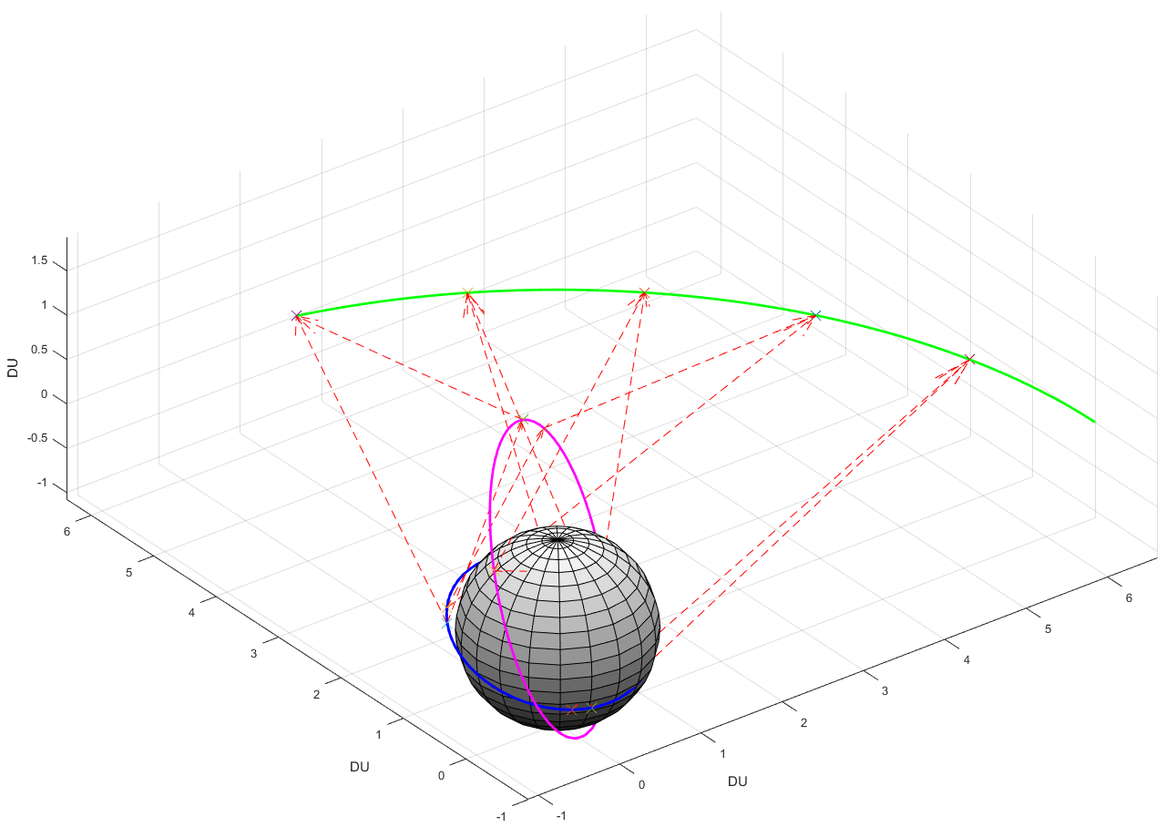
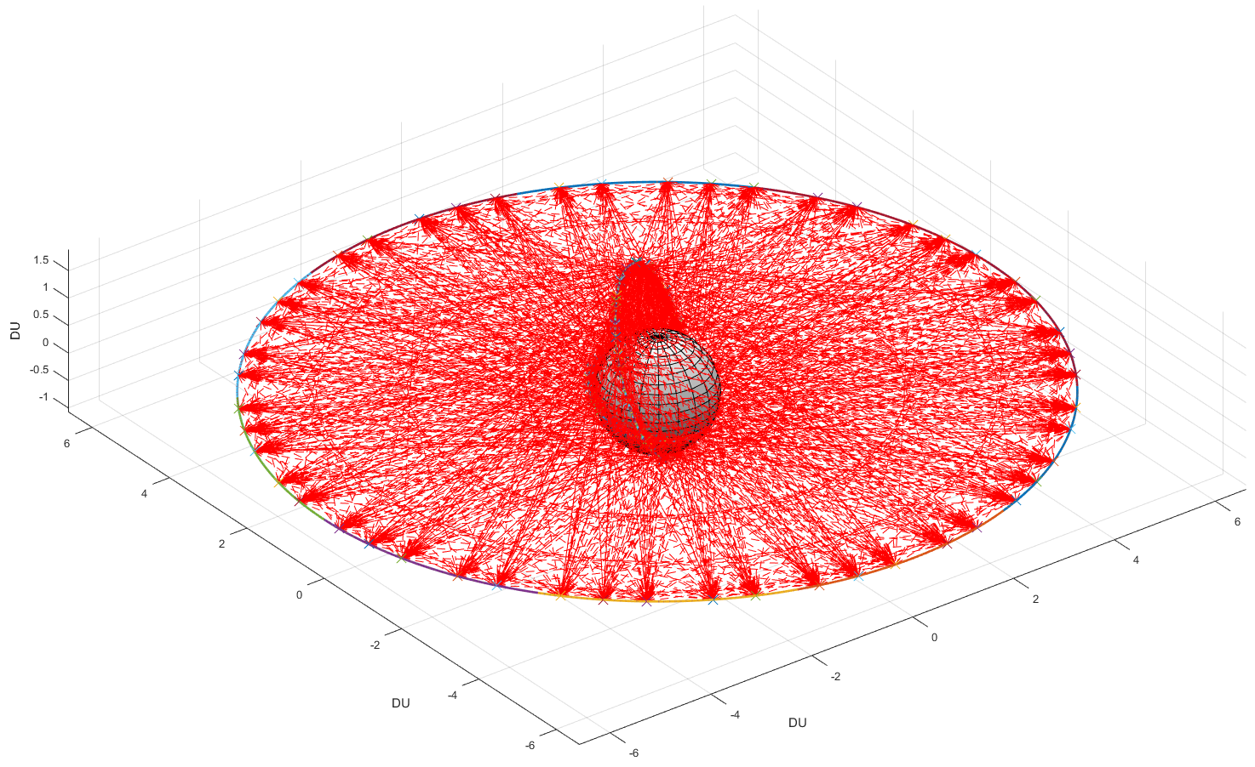
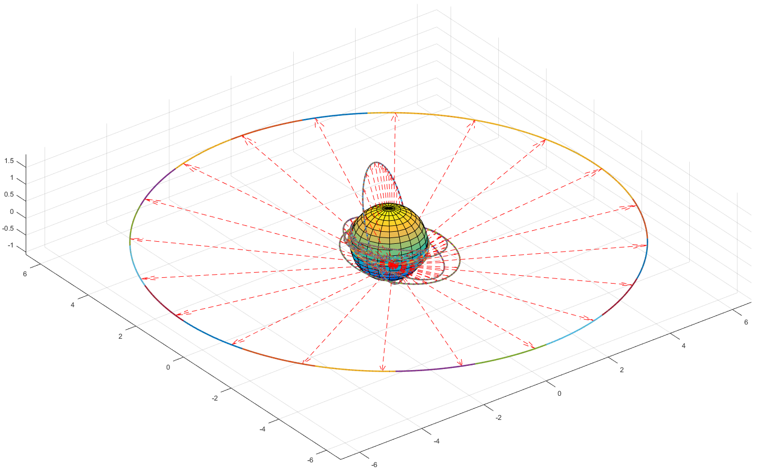
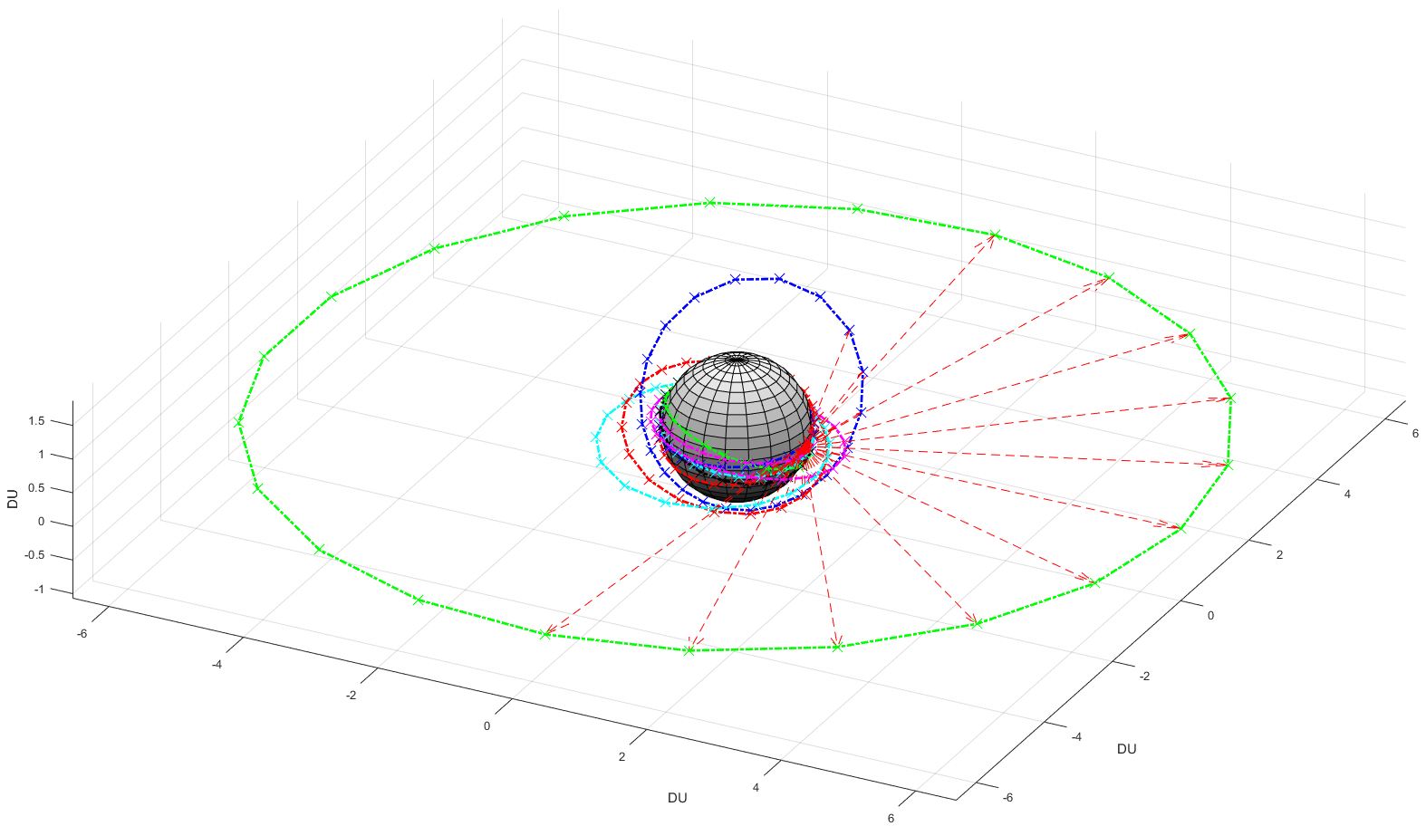
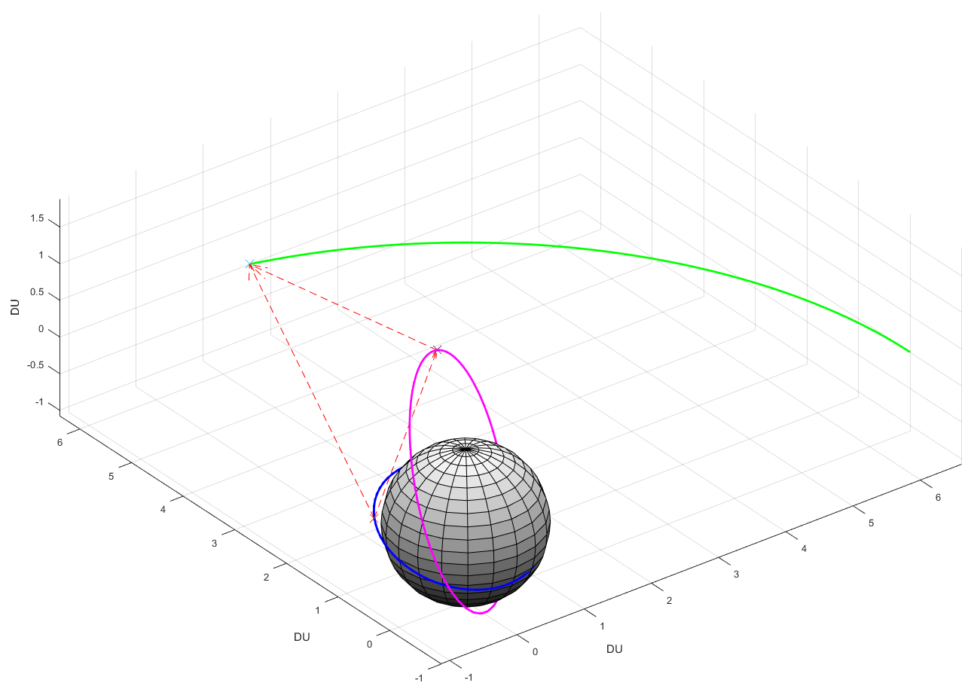




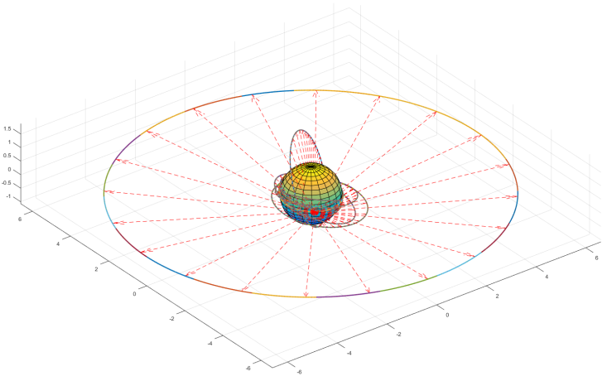
Problem Statement
Triangular number scales at O(n²)
LOS test methods scale at O(n) or O(n log n)
Need to attack triangular number

Slide 10
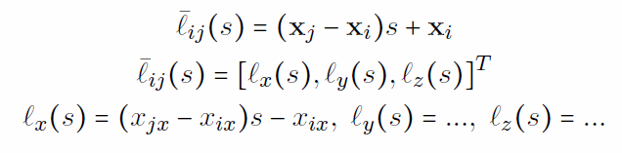
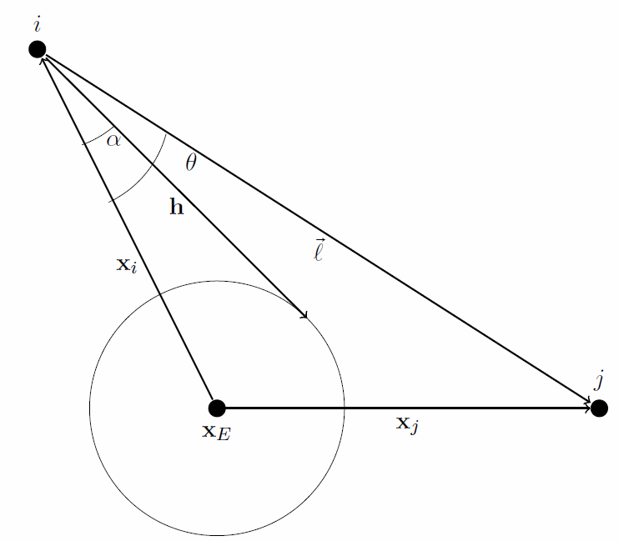
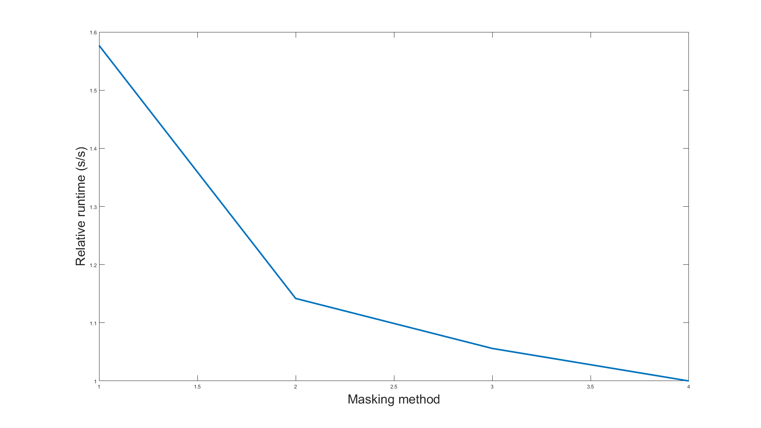
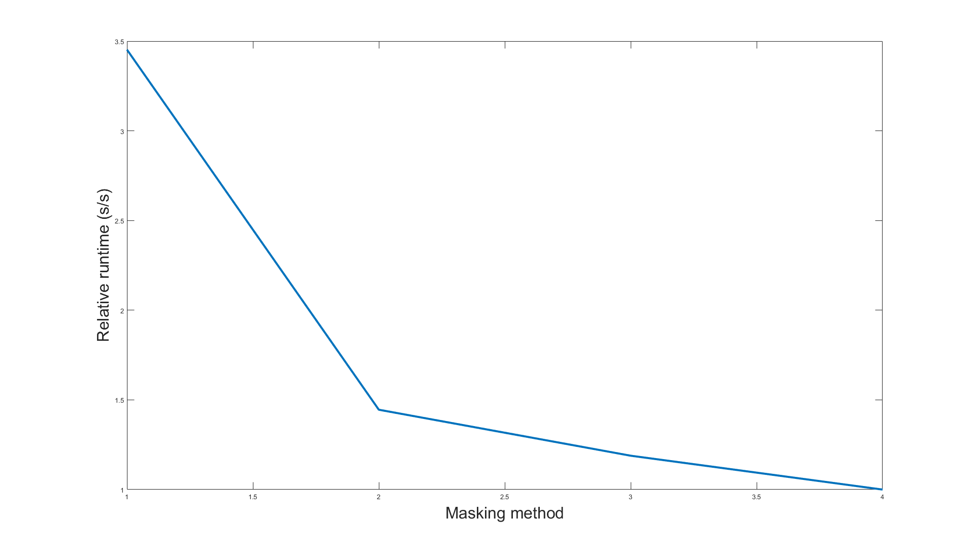
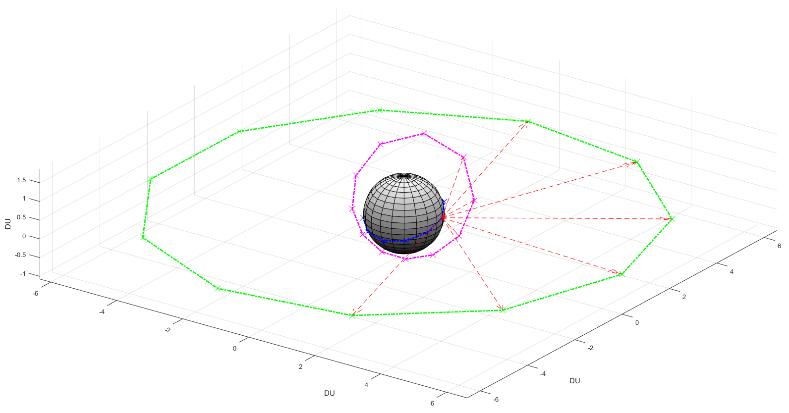
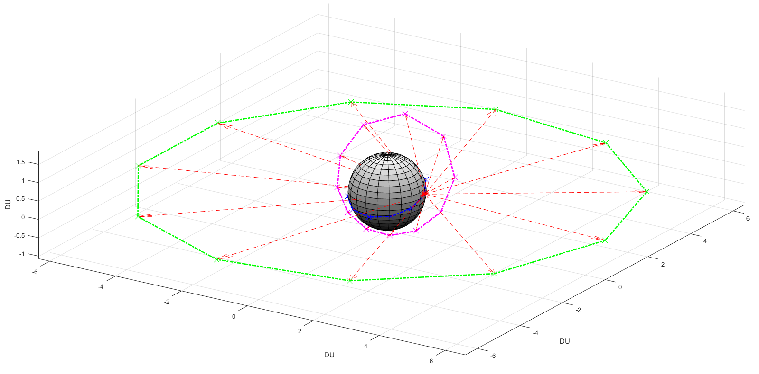
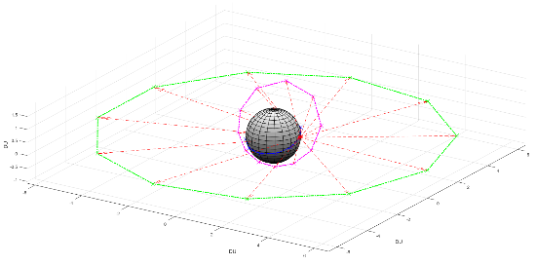

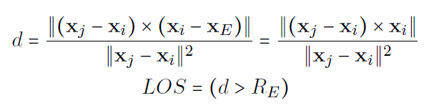
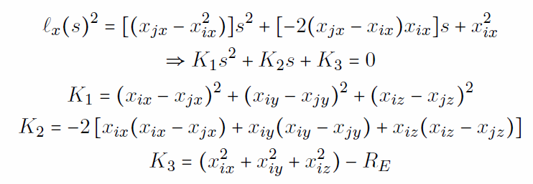
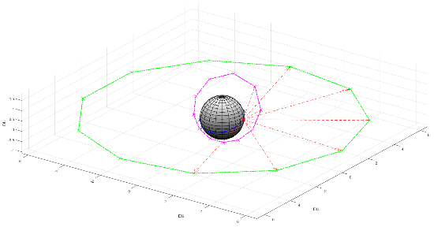

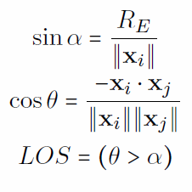
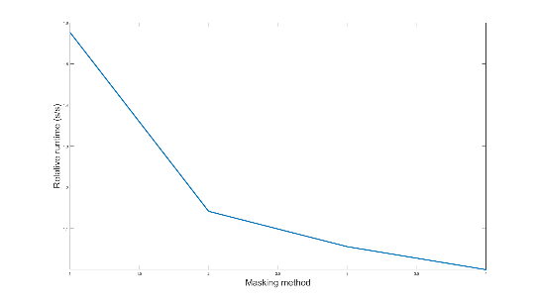

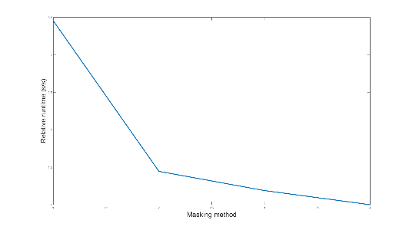
Discretization & Mask
3 methods:
Sight angle method
Point-line distance
Body intersection
Results were surprisingly effective:

Slide 11
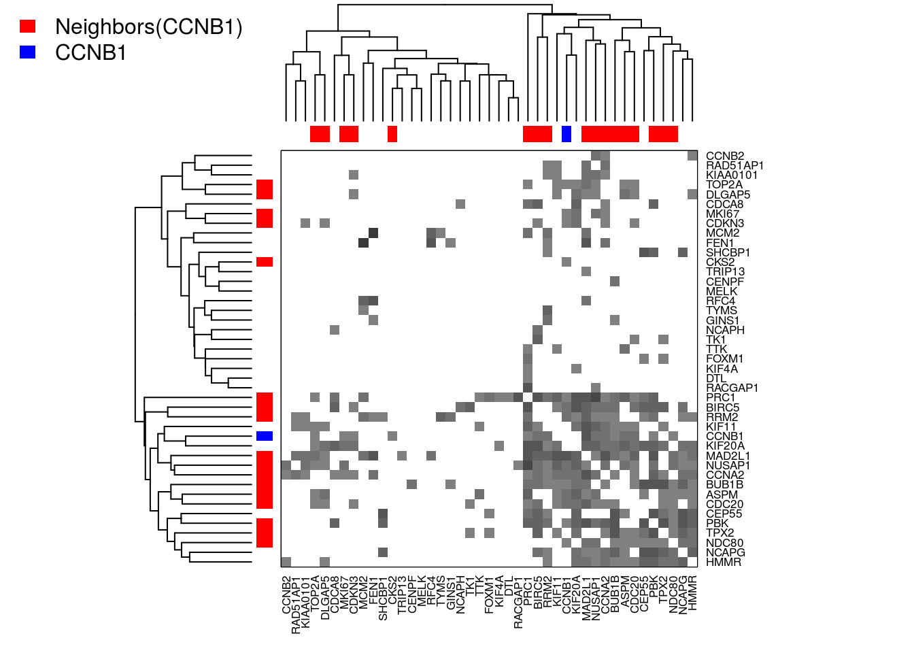
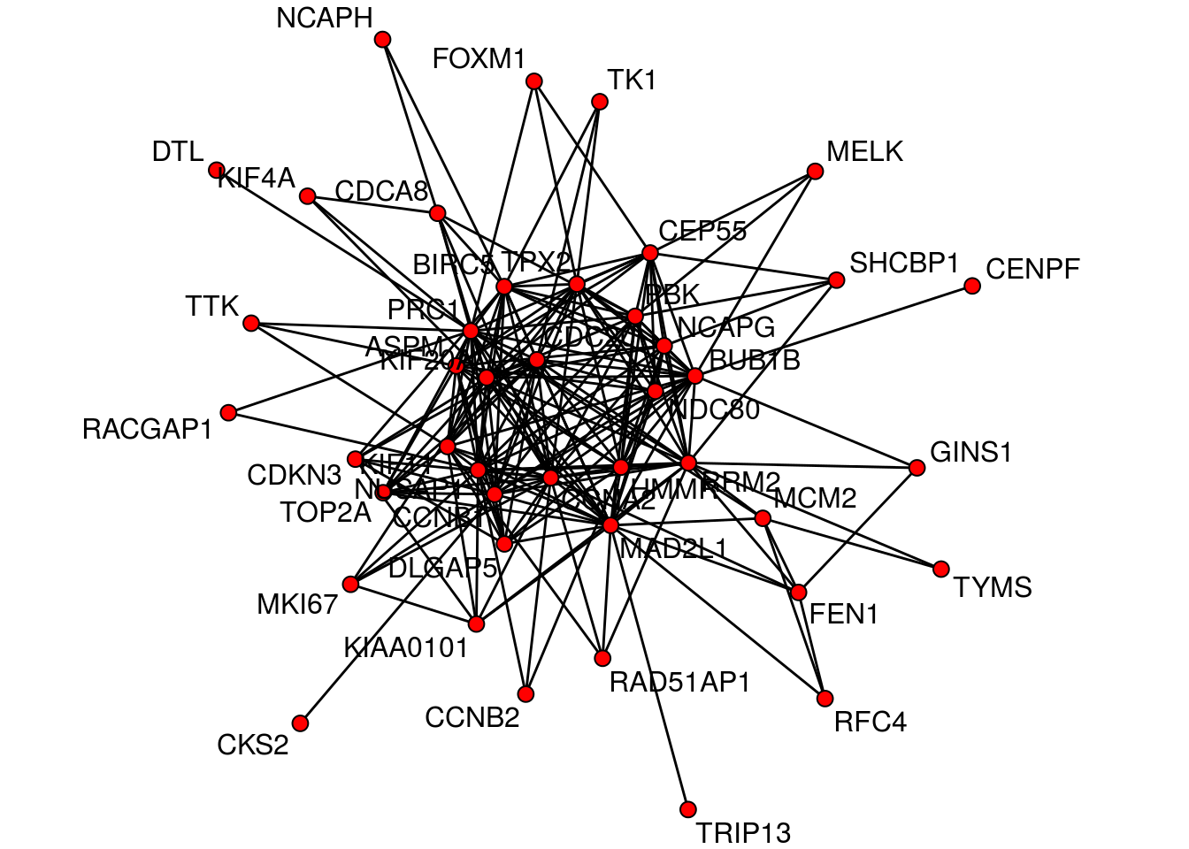
Large-Scale Graph Computation with PETSc - Dezhi Fang
Large scale graph computation are ubiquitous
Real-world graphs are sparse
U. et. Al: Graph computations can be expressed in Matrix Multiplication

Slide 12
PETSc & SpMV
One of the “seven dwarfs”
Many advanced techniques in PETSc
  MPIAIJ Format
Easily Parallelizable
  Each processor hold a number of rows
  Low amount of MPI messages

Slide 13
Performance
128 Cores
4 cores

Slide 14
Scalability Testing of Geant4
Joe Harms
CSE 8803 Term Project
November 30, 2016

Slide 15
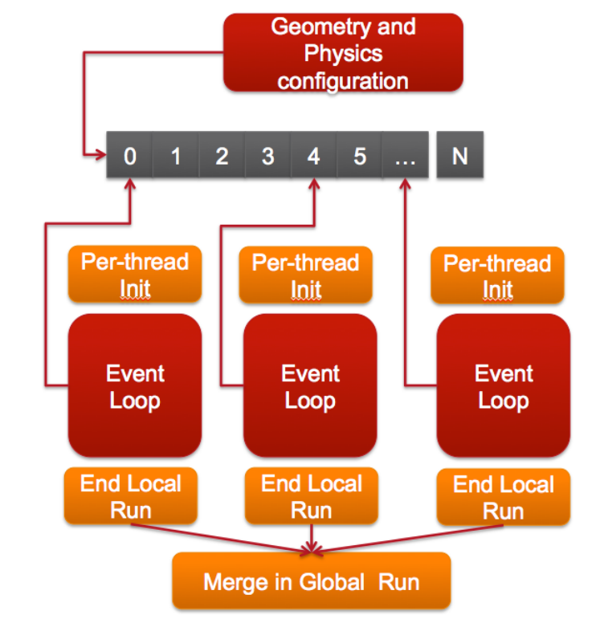
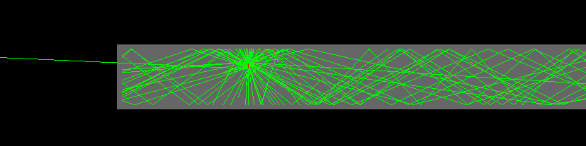
Introduction
Geant4 is a Monte Carlo based simulation toolkit for radiation transport with applications in high-energy physics and nuclear science
Testing the scalability of Geant4’s scintillation physics
Various Energy Gamma’s are launched into a LYSO detector

Slide 16
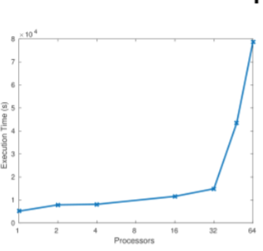
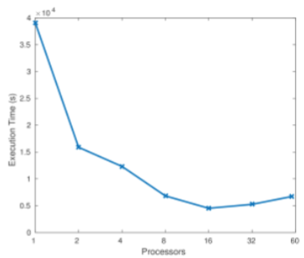
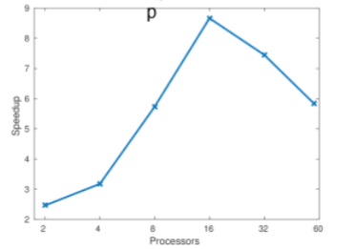
Results
Speedup
Weak Scaling
Strong Scaling

Slide 17
Empirical Likelyhood Method in C vs R
Yanxi Hou
School of Mathematics
Georgia Institute of Technology
November 30, 2016

Slide 18
Methodology
Implementation of Empirical likelihood method
In R, el.test in package “emplik”
In C, my own function eltest.c
The same algorithm both in R and C programs
First speedup from R to C, future projects in parallel program and extensions of empirical likelihood method
Six simulation cases

Slide 19
Simulation
Case | Time(seconds) | -2LLR |  |  | Iterations | iterations
 | R | C | R | C | R | C
n=100,p=10 | 1.838 | 0.022 | 7.03488 | 7.03488 | 5 | 4
n=1000,p=10 | 1.877 | 0.039 | 9.144474 | 9.144474 | 4 | 9
n=10000,p=10 | 2.370 | 0.336 | 8.286966 | 8.386966 | 4 | 4
n=100,p=20 | 1.887 | 0.024 | 22.9094 | 22.9094 | 6 | 6
n=1000,p=20 | 1.980 | 0.108 | 13.49183 | 13.49183 | 4 | 4
n=10000,p=20 | 2.760 | 1.451 | 23.5809 | 23.5810 | 4 | 6

Slide 20
Hybrid MPI/OpenMP for Diffusion Equation
Achyut Panchal
CSE 8803: Term Project

Slide 21

Problem and Numerical Method
T_{wall} = 1500 K
Heat diffusion equation solved over a square domain
2nd order explicit scheme
Discretized using uniform grid
T_{init} = 300 K
Initialize
For each step
Possible parallelism
For each point
MPI parallelism using domain decomposition (MPI_Cart_Create)
Communication required at each time step
Update T_{i,j}
Additional computation
Finalize
OpenMP directive for the outer for loop (costliest)
pragma omp parallel for private(..) collapse(2)

Slide 22
MPI vs OpenMP
Single node:
MPI speedup flatten for n > 10
OMP worse than MPI, flattens for n > 4
Cost of thread-creation
Performance better if point-wise computations made costly (reaction, thermo).
OMP slightly worse than MPI
Multiple nodes:
Hybrid MPI/OMP preferred for costly point-wise computations, very minor benefits
Not much benefit from bypassing communications

Slide 23
Unbalanced Problems
Applications: Lagrangian particle simulations
MPI performance bad if not possible to load-balance the problem beforehand
Standard OMP performance as bad as MPI
Need to use schedule(dynamic, xx)
Effect of various chunk sizes different for different number of threads.
Conclusions:
Hybrid programming not very helpful for well-balanced problems and only minimal gains in specific cases
Useful for badly load-balanced cases, useful if memory bound problem
Need to look more into memory management
What if communication bound problem?

Slide 24
PETSC Implementation of a Matlab Model of Cell Morphodynamics
William Pilcher
Original Model by Siarhei Hladshu

Slide 25
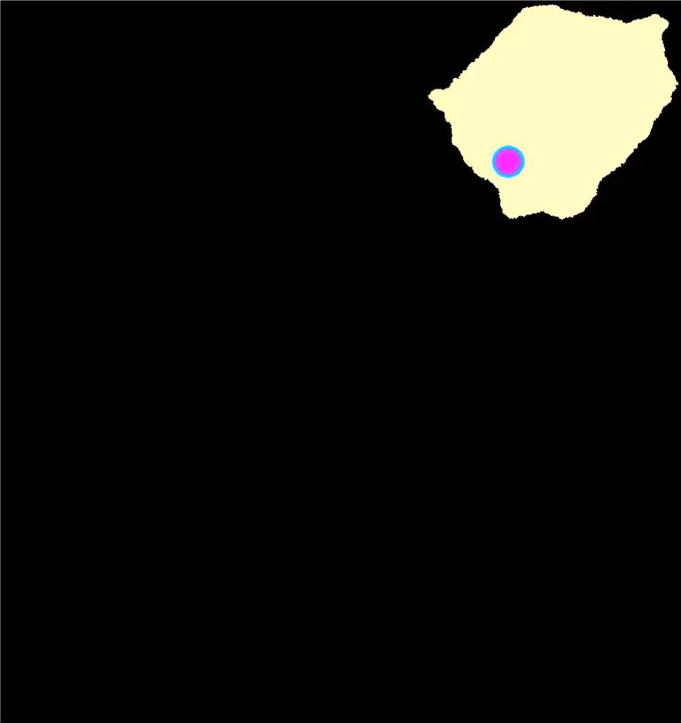
Model Description
Goal – Link the motion of the cell membrane with the underlying chemical reactions
  Two Stages
    1) Reaction Diffusion – Determines GTPase activity within the cell
    2) Cellular Plots – Updates the cell border based on local GTPase activity
    Reaction Diffusion takes >99% of computation time
    The Cellular Plots model is not intuitively parallelized

Slide 26
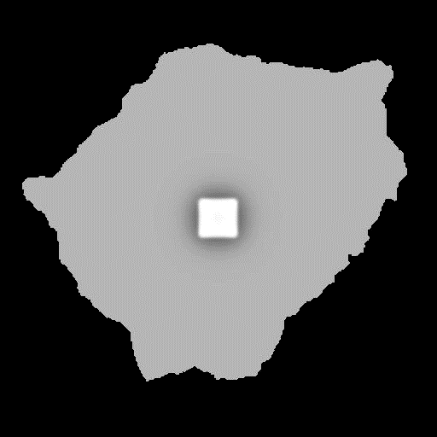





Model Description
Reaction Diffusion
  Models Activation and inactivation of GTPase (A <-> I) and formation of actin fibers (F)
  Active GTPase promotes the formation of actin fibers
  Active and Inactive GTPase can diffuse independently
    The reaction term for the exchange of active and inactive GTPase is highly non-linear and depends on the concentration of all parameters
  Cell is not a square shape
  No-flux boundary conditions (Homogenous)
  Minor changes in parameters leads to very different behaviors
A
Arp2/3
GEF
GAP
PI3K
F
GEF
I

Slide 27
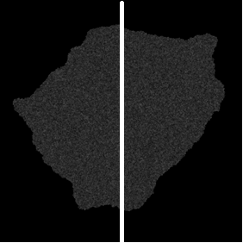
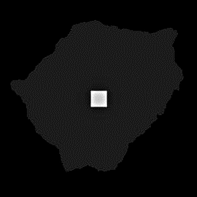
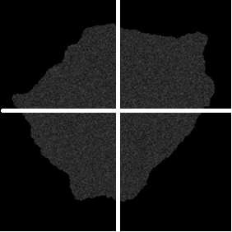
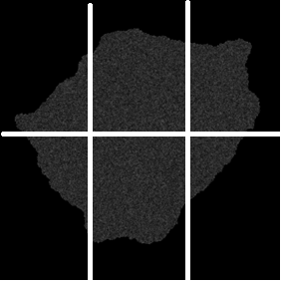
Results
MATLAB
PETSC
PETSC and MATLAB both used Euler’s Method
  Matlab code was vectorized and does take advantage of multiple cores
  Task Tested:
    Read initial conditions from file
    Compute 50,000 Euler Timesteps
Results
  Outputs are identical
  PETSC runs 8-10 times faster than MATLAB code at the same thread count
  PETSC tends to have better parallel efficiency
  Potential Load Balancing Issues

Slide 28
N-Body Simulations with EXAFMM
Arvind Singh
CSE8803: Course Project

Slide 29
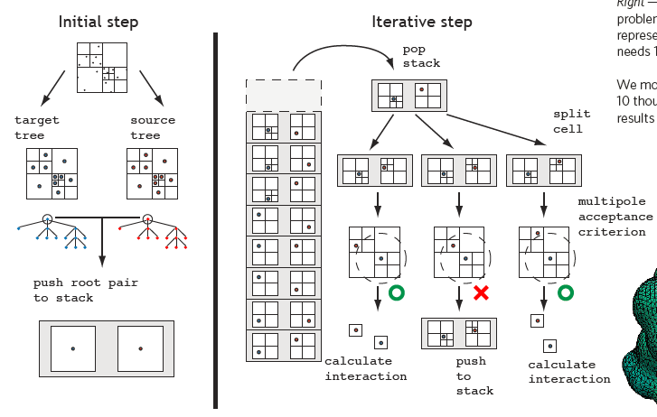
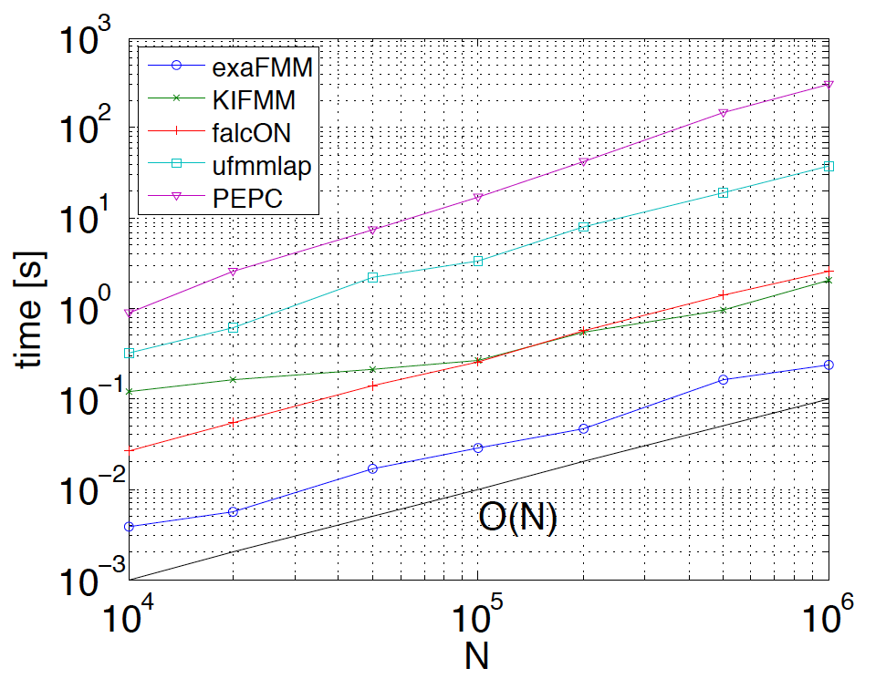
N-Body Simulations With EXAFMM
One of the “seven dwarfs of HPC”
Laplace Kernel:
1. Equation:
2. Initial Conditions
3. Upon discretization, this yields system that can be solved iteratively, with matrix vector products accelerated using FMM
Methods | Comp. Complexity
Treecode | O(N logN)
FMM | O(logN)
Hybrid | O(logN)
Treecode: Clusters remote particles into larger groups and uses ME
FMM: Clusters not only the remote particles but also the nearby particles using LE
EXAFMM Algorithm
Benchmarks
R. Yokota et. al., “ExaFM: An open source library…”, 2012
L. Barba et. al., “Hierarchical N body simulations…”, IEEE CS&AIP, 2012
R. Yokota et. al., “A tuned and scalable FMM…”, HPC applications, 2012
R. Yokota et. al., “N Body Methods on Xeon Processors”, H3P, 2014
R. Yokota, “An FMM based on Dual Tree…”, JACT, 2013
single socket of a Xeon X5650 (2.67G, 6 cores)

Slide 30
Results
Tree Structure
N. Bodies | N. Cells | Tree Depth
1E4 | 585 | 3
1E5 | 4681 | 4
1E6 | 36449 | 5
Impact of Multipole Acceptance Criterion
 | L2 Error
N. Bodies | MAC=0.2 | MAC=0.4 | MAC=0.6
1E4 | 5.45E-08 | 5.36E-05 | 4.39E-03
1E5 | 5.88E-08 | 3.94E-05 | 1.09E-02
1E6 | 6.97E-08 | 4.10E-05 | 3.55E-03
Summary: EXAFMM is the best available FMM solver which has some attractive features such as
Hybrid Implementation: FMM + Treecode
Dynamic Load Balancing on Heterogeneous Architectures
Optimized for various CPU/GPU Architectures

Slide 31
A parallel flamelet solver for detailed chemistry mechanisms
CSE8803 Final Project Presentation
Umesh Unnikrishnan
November 30, 2016

Slide 32
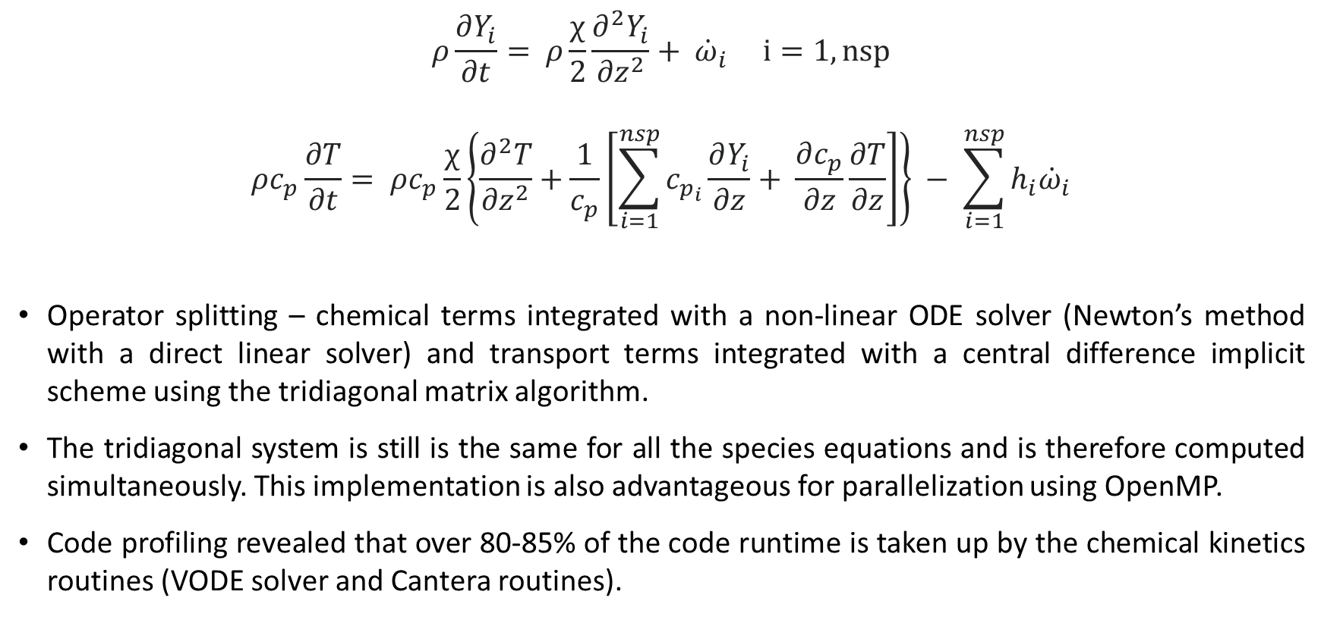
Flamelet model and Solver description
Species Equations
Operator splitting – chemical terms integrated with a non-linear ODE solver (Newton’s method with a direct linear solver) and transport terms integrated with a central difference implicit scheme using the tridiagonal matrix algorithm.
The tridiagonal system is still is the same for all the species equations and is therefore computed simultaneously. This implementation is also advantageous for parallelization using OpenMP.
Code profiling revealed that over 80-85% of the code runtime is taken up by the chemical kinetics routines (VODE solver and Cantera routines).
Energy Equation

Slide 33
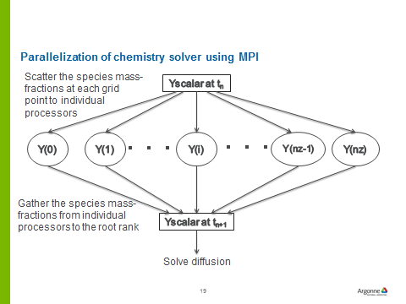
Code performance improvement
Parallelization of the chemical kinetics solver using MPI
Testing with the 103 species mechanism with 64 grid points
~35 minutes on a single processor
~1 minute on 64 processors
But for the detailed 2115 species mechanism, the
computation time was still prohibitive.
Analytical Jacobian and Sparse linear solver
Jacobian matrix is essentially sparse
Reduces the Jacobian computation - O(n²) and LU factorization – O(n³) computations to O(n).
In serial, the new method takes ~6 mins for 103sp and ~4 hours for the 2115sp mechanisms.
In parallel, the runtime with the 2115sp mechanism is about ~15 minutes.

